Slide 1
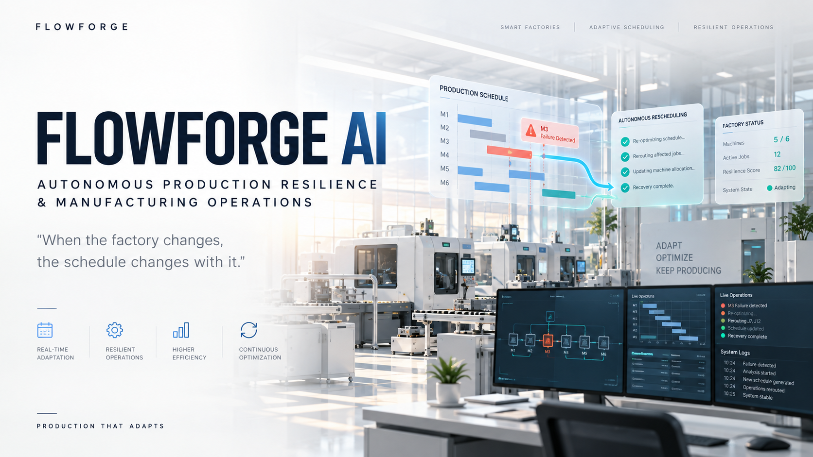
TEAM- Stack_OverFlow

Slide 2







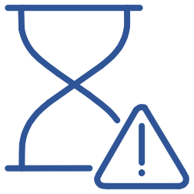


FACTORIES DON'T FOLLOW THE PLAN.
When the schedule breaks, operations have to adapt in real time.
Disruptions
Consequences
Machine failure
Rush order
Manual rescheduling
Idle capacity
Cascading delays
Deadline shift
Cancellation
Missed deadlines
Energy inefficiency
The problem isn't creating a schedule. It's keeping the factory running when the schedule breaks.
TEAM- Stack_OverFlow

Slide 3

SO WHY SHOULD THE SCHEDULE?
FLOWFORGE AI is an adaptive production-resilience layer that detects operational changes, re-optimizes active production, reroutes affected work and measures recovery.
1
2
3
4
5
Disruption Detection
Adaptive Rescheduling
Precedence-Aware Recovery
Resilience Measurement
Operational Explanation
Identifies machine failures, rush orders, deadline shifts, and cancellations in real time.
Re-optimizes the active schedule the moment conditions change.
Scores operational health before, during, and after every disruption.
Generates human-readable audit trails for every recovery decision.
Reroutes work while respecting all operation ordering constraints.
TEAM- Stack_OverFlow

Slide 4
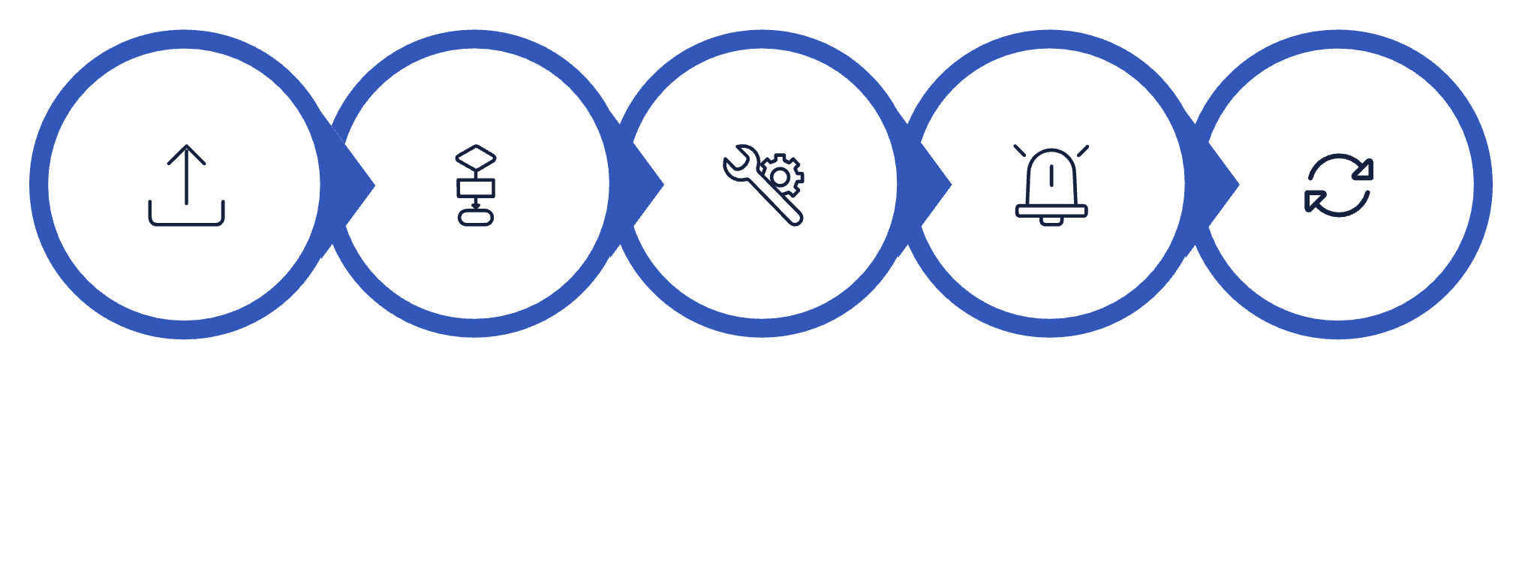
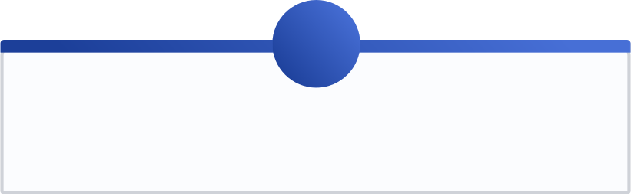
FROM SCHEDULE TO RESILIENT OPERATION
INGEST
OPTIMIZE
OPERATE
DISRUPTION
RE-OPTIMIZE
Optimization Engine
Disruption Types Handled Output
Multi-objective Genetic Algorithm — Input via Excel, JSON, or
default factory data.
Recovered schedule + rerouted operations
Updated KPIs + resilience score
Explanation / audit trail
1
2
3
4
30% Makespan
35% Tardiness
15% Downtime
20% Energy
Machine failure
Urgent job insertion
Deadline change
Job cancellation
Unplanned downtime
TEAM- Stack_OverFlow

Slide 5
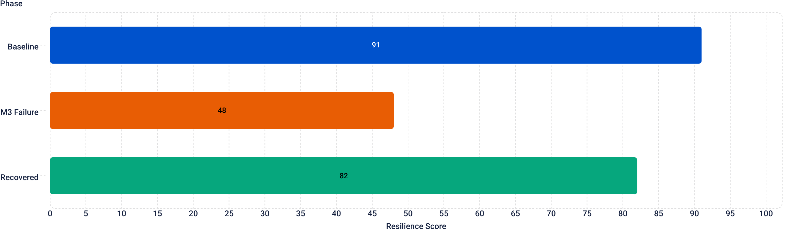
WATCH IT RECOVER.
Live demo scenario — 6 machines, 12 jobs. Machine M3 fails mid-production.
91
48
Baseline Score
After M3 Fails
Makespan 105 min · Tardiness 0 · Utilization 76.2% · Energy 71.2 kWh
J7 + J12 affected · Only 5/6 machines available · Resilience collapses
82
0.18s
After Recovery
Recovery Time
J7 + J12 rerouted · Makespan 125 min · Tardiness 0
· Energy 66.5 kWh · Late jobs: 0
Measured demo result — full re-optimization computed in under a fifth of a second
TEAM- Stack_OverFlow

Slide 6

THE INTELLIGENCE BEHIND THE RECOVERY
1
2
3
LAYER 1 — OPTIMIZATION
LAYER 2 — RESILIENCE ENGINE
LAYER 3 — AI REASONING
Multi-objective Genetic Algorithm — Permutation chromosome · Population: 20 · Generations: 30 · Mutation rate: 0.10 · Binary tournament selection · Order crossover + Swap mutation
Claude 3.5 Sonnet — Advisory only. Root-cause reasoning · Identifying affected entities · Actionable operational guidance · Deterministic expert fallback when unavailable.
Detects disruptions in real time and computes full recovery plans — rerouting affected operations while respecting all machine and precedence constraints.
Supporting Intelligence
Tech Stack
SPT / EDD dispatching heuristics
Temporal constraint interval propagation
Fuzzy header / synonym matching
Python · FastAPI · Uvicorn · Pydantic · OpenPyXL
HTML / CSS / JavaScript · GSAP · SVG/Canvas Gantt
Pytest
TEAM- Stack_OverFlow

Slide 7


FROM SCHEDULING TO RESILIENCE.
Static Scheduling
FLOWFORGE AI — Closed Loop
Create once
SCHEDULE
OBSERVE
DISRUPT
Assumes stable conditions throughout production.
Manual recovery
Delayed human response when disruptions occur.
RECOVER
MEASURE
EXPLAIN
Limited visibility
No measurement of disruption impact or recovery quality.
Applications
Job-Shop Manufacturing
CNC / Precision
Production Cells
Make-to-Order
TEAM- Stack_OverFlow

Slide 8









TODAY, FLOWFORGE REACTS. TOMORROW, IT PREDICTS.
CURRENT
FUTURE SCOPE
Adaptive scheduling
Predictive maintenance
Disruption recovery
Live IoT telemetry
Resilience measurement
Digital twin
AI-assisted operational reasoning
Reinforcement learning
MES / ERP integration
DON'T JUST OPTIMIZE THE FACTORY. MAKE IT RESILIENT.
FLOWFORGE AI
TEAM- Stack_OverFlow

